Slide 1
Robotics 1
Industrial Robotics

Slide 2
What is a robot?
industrial definition (RIA = Robotic Institute of America)
re-programmable multi-functional manipulator
designed to move materials, parts, tools, or specialized devices through variable programmed motions for the performance of a variety of tasks, which also acquire information from the environment
and move intelligently in response
ISO 8373:2012 definition
an automatically controlled, reprogrammable, multipurpose manipulator programmable in three or more axes, which may be either fixed in place or mobile for use in industrial automation applications
more general definition (“visionary”)
intelligent connection between perception and action

Slide 3
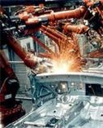
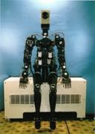
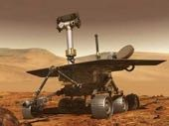
Robots !!
Spirit Rover (2002)
Comau H4 (1995)
Waseda WAM-8 (1984)

Slide 4
A bit of history
Robota (= “work” in slavic languages) are artificial human- like creatures built for being inexpensive workers in the theater play Rossum’s Universal Robots (R.U.R.) written by Karel Capek in 1920
Laws of Robotics by Isaac Asimov in I, Robot (1950)
A robot may not injure a human being or, through inaction, allow a human being to come to harm
A robot must obey orders given to it by human beings, except where such orders would conflict with the First Law
A robot must protect its own existence as long as such protection does not conflict with the First or Second Law

Slide 5
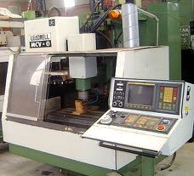
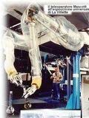
Evolution toward industrial robots
computer numerically controlled
machines (CNC)
1950
mechanical telemanipulators
robot manipulators
1970
Unimation PUMA
with respect to the ancestors
flexibility of use
adaptability to a priori unknown conditions
accuracy in positioning
repeatability of operation

Slide 6
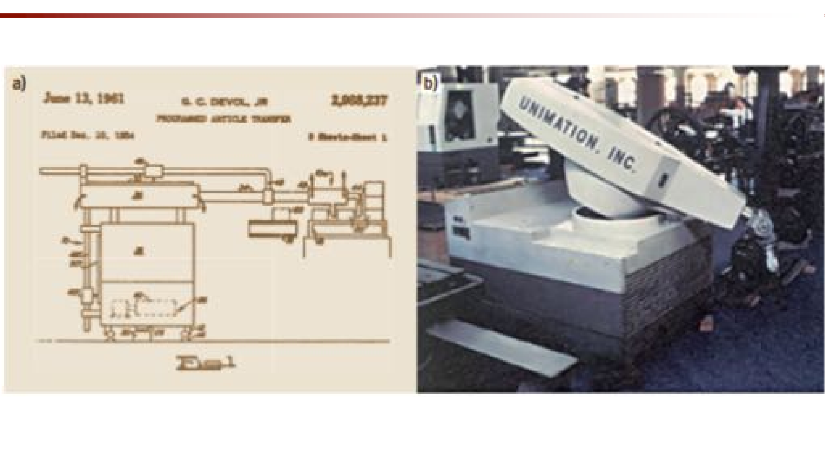
The first industrial robot
US Patent General Motor plant, 1961
G. Devol and J. Engelberger (Unimation)

Slide 7
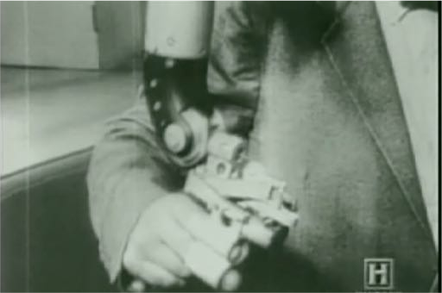
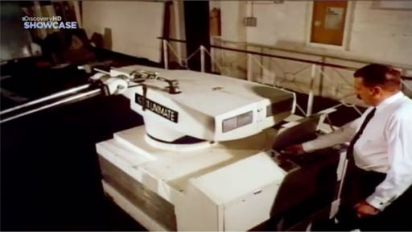
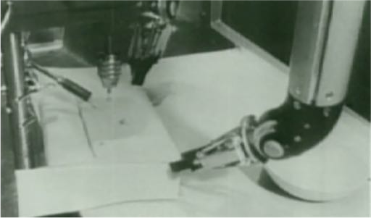
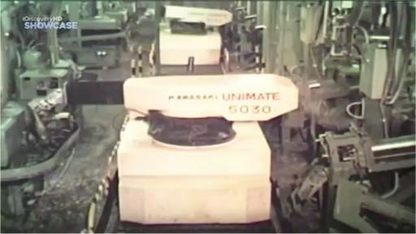
Historical pictures and clips
video
video
bimanual remote manipulation at Oak Ridge Nat’l Labs
Unimate 6-dof robots

Slide 8
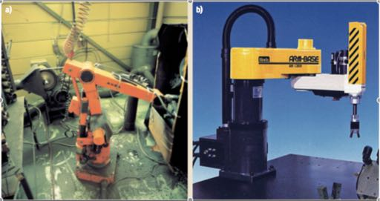
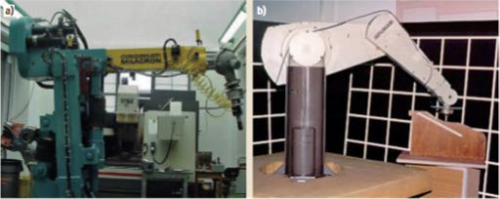
Robot manipulators
ASEA IRB-6 (1973)
first robot
all-electric-drives
Hirata AR-300 (1978)
first SCARA robot
Cincinnati Milacron T3 (1974)
first micro- computer controlled robot
Unimation PUMA 560
(1979)
6R with human-like dexterity

Slide 9


robots – a 50-year journey
robotics research up to 2000
Video compiled for the IEEE ICRA 2000 conference, S. Francisco

Slide 10
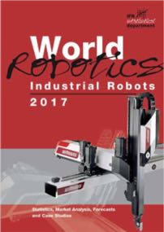
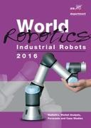
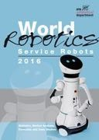
World Robotics 2017
executive summary for 2017
statistics by IFR issued yearly in early October
(last one published; for 2018 edition + back issues since 2008, check course web site)
robotics market value in 2016: $13.1 billion (+18% over 2015); robot systems: $40 billion
total worldwide stock at end 2016: 1.8 million units of operational industrial robots (+12%)
highest ever robot sales worldwide in 2016 (~295K, +16%), for the fourth year in a row
China expanded further as the largest market since 2013, now with a 30% share (+3%)
75% of sales goes to 5 countries: first is China (87K, close to Europe + Americas = 97K), then Korea (41K, +10%/year average since 2011), Japan (38K, +10%), USA (31K, +14%), and Germany (20K, steady); Italy (6.7K, steady) is the 2nd market in Europe (7th worldwide)
main industrial drivers: automotive (35% of new robots, with moderate rate increase) and electrical/electronics (31%, catching up very fast; now first in Asia), followed by metal and machinery, rubber and plastics, food industry, ...
a continued accelerated growth!

Slide 11
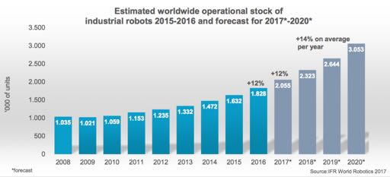
Diffusion
industrial robots in operation worldwide
2008-2016
2020*: ~3M robots in operation
(as reference: industrial robots in stock in 1973 = 3K, in 1983 = 66K) length of robot service life is estimated in 12-15 years

Slide 12
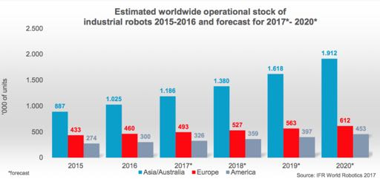
Diffusion
industrial robots in operation by world area
2020*: ~1.9M robots in Asian factories ...
... out of which almost 1M operating in China!

Slide 13
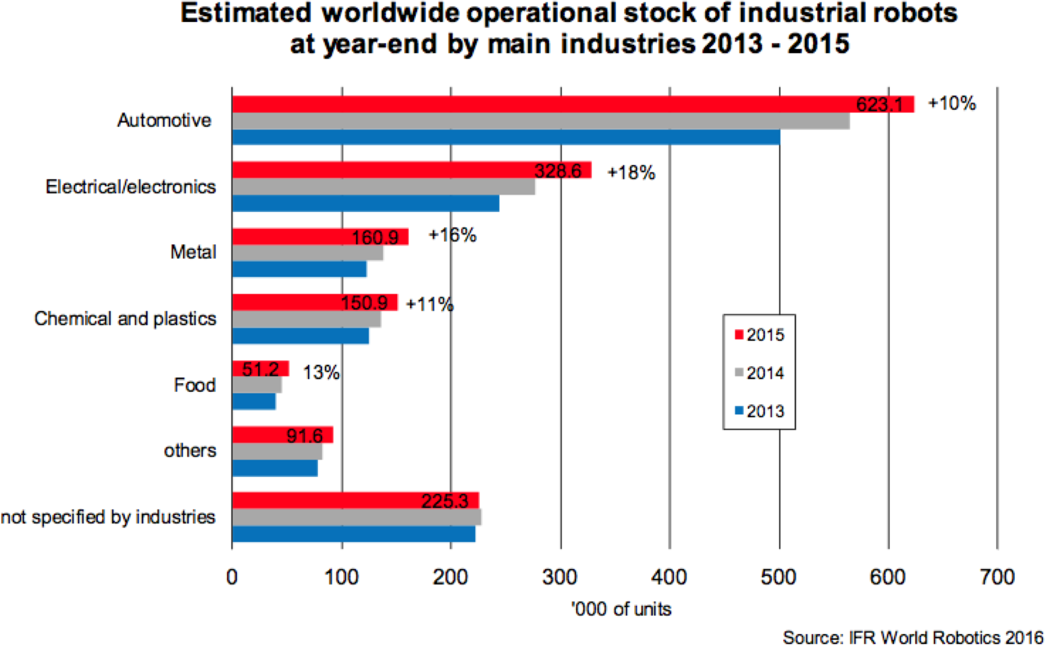
Diffusion
robots in industrial sectors
Robotics 1
almost 70% of robots are in three main industries
13

Slide 14
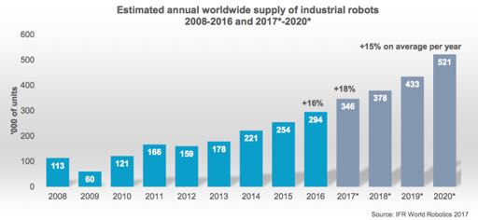
Annual supply
new industrial robots worldwide
double-digit average annual increase
highest level ever: 294K new units
2017*-2020*: forecast of 1.7M new industrial robots

Slide 15
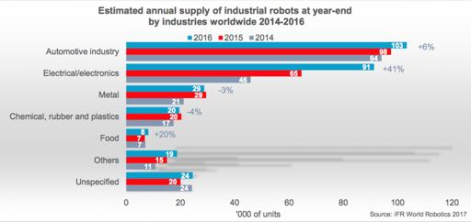
Annual supply
new robots by industrial sectors
continued increase in major industries

Slide 16
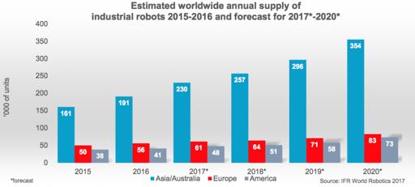
Annual supply
new industrial robots by world area
2020*: 40% of the global supply of new robots will go to China

Slide 17
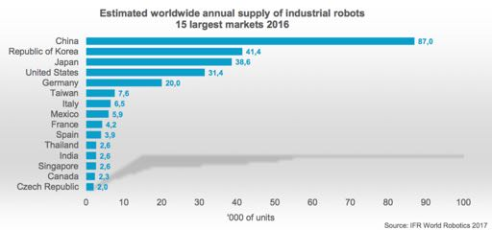
Annual supply
new installations in top markets (countries)
in 2016: 5 markets account for 75% of total supply

Slide 18
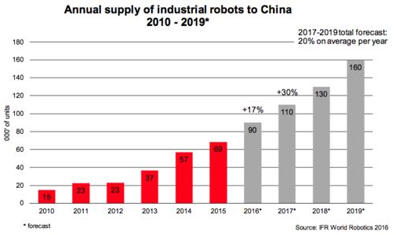
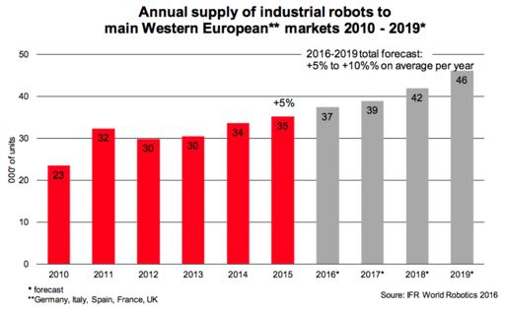
Annual supply
market comparison of new industrial robots
China:
largest market since 2013
40% of global supply in 2019*
now also producing robots for their internal market...
Western EU:
Germany, Italy, France, Spain, and UK have a slow but steady increase

Slide 19
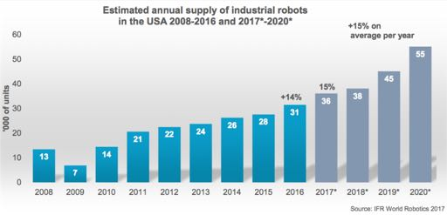
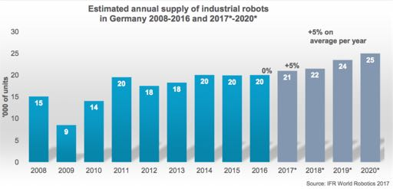
Annual supply
market comparison of new industrial robots
USA:
considerable increase since 2010
Germany:
moderate increase at record levels in Europe

Slide 20
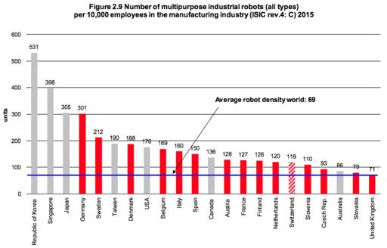
Density of robots
631
Italy: degree of automation still relatively high, but not increasing in comparison to other countries
309
488
²303
74
Average robot density in USA: 184, Europe: 99, Americas: 84, Asia: 63
68
China
number of robots per 10000 employees
in the manufacturing industry in 2015 (and 2016)
Robotics 1
20

Slide 21
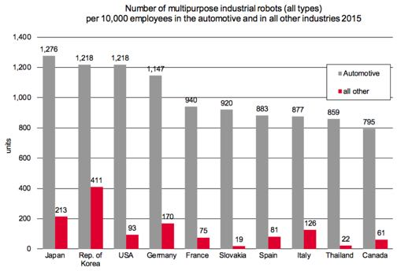
Density of robots
²1240
2145!!
1261
Italy was at 2nd place in 2011!
²1131
1150
1051
comparatively still low density
in general industry
number of robots per 10000 employees
in the automotive and in all other industries in 2015 (and 2016)

Slide 22
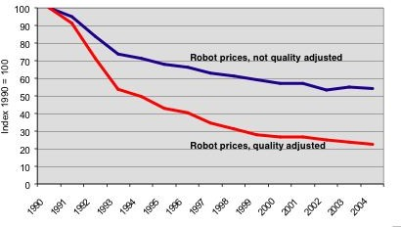
A long-range trend in robot prices
An articulated industrial robot with six degrees of freedom of medium size costs about 80-100 KEuro

Slide 23
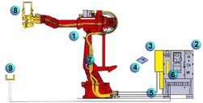
Industrial robot
and its auxiliary equipments
Comau SMART H robot
C3G Plus controller
Welding control box
Application software
Air/water supply
SWIM Board
Integrated cables
Welding gun
Auxiliary devices in the robotic cell
(servo-controlled axes)
SWIM = Spot Welding Integrated Module

Slide 24
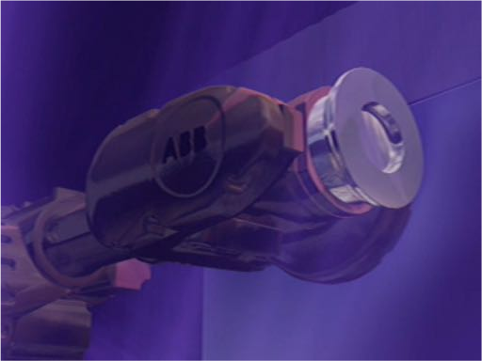
ABB IRB 7600
commercial video by ABB

Slide 25
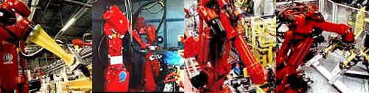
Industrial applications
manipulation (pick-and-place)
assembly
spray painting and coating
arc welding
spot welding with pneumatic or servo-controlled gun
laser cutting and welding
gluing and sealing
mechanical finishing operations (deburring, grinding)

Slide 26
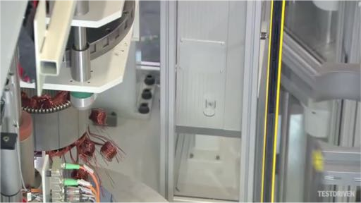
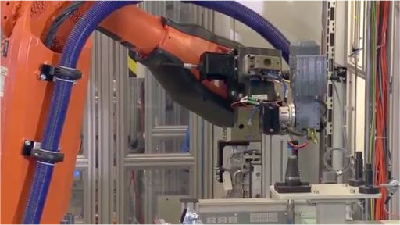
A day in the life of an industrial robot
At BMW car production line with ABB robots
pick-and-place
with end-effector to reorient part
video video
pick-and-place
with support to reorient part

Slide 27
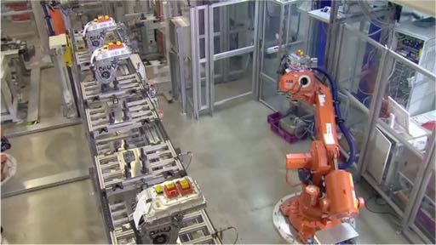
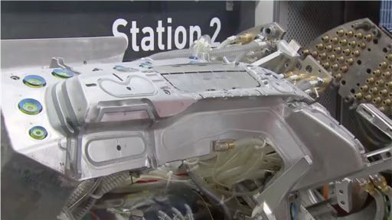
A day in the life of an industrial robot
pick-and-place
heavy parts and human intervention
video video
metal cutting
on a supporting machine with dofs (video speeded up at some point)

Slide 28
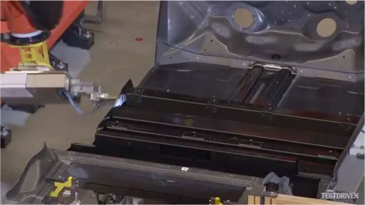
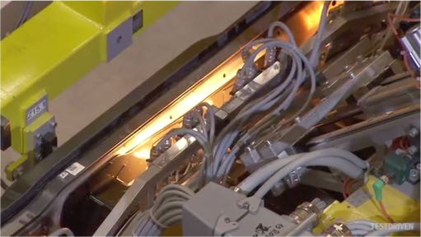
A day in the life of an industrial robot
glue deposit
(on fancy paths!)
video video
cooperation of multiple robots
for handling and sealing a car body

Slide 29
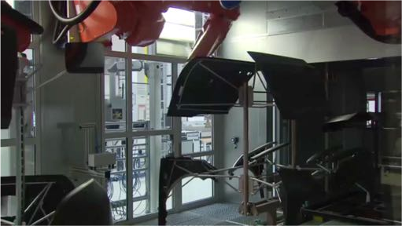
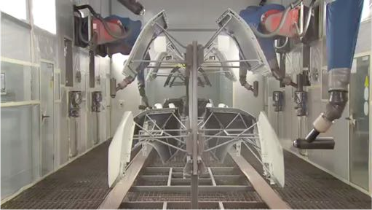
A day in the life of an industrial robot
coating parts
for rust and corrosion protection
video video
spray painting

Slide 30
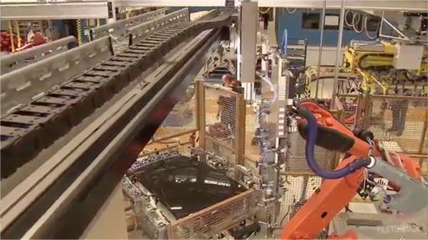
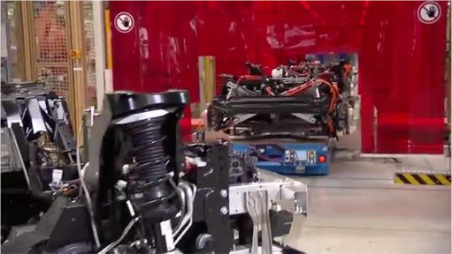
A day in the life of an industrial robot
hood deburring
with a suspended tool
video video
test measurements
with assembly on a AGV

Slide 31
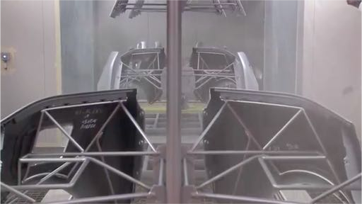
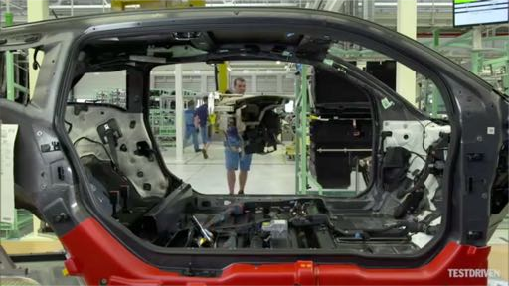
What a robot should do and what cannot do
yet
video
video
spray painting
very unhealthy for human operators
assembly of flexible or complex parts
(here a car dashboard)
⇒ human-robot collaboration (co-bots or co-workers)

Slide 32
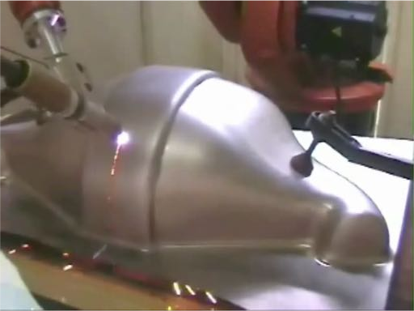
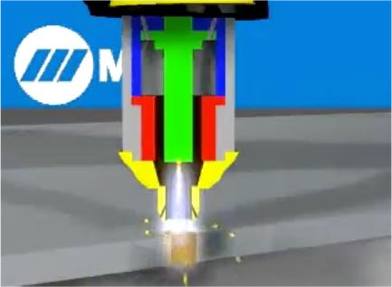
Plasma cutting
video
electrode
gas chamber
nozzle
hot plasma
small KUKA robot used for plasma cutting of a stainless steel toilet (courtesy of Engenious Solutions Pty)

Slide 33
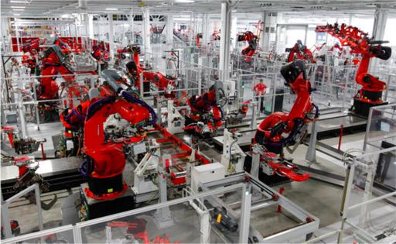
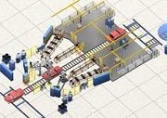
Robotized workcells

Slide 34
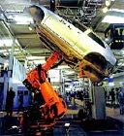
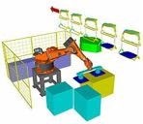
3D simulation of robotic tasks
analysis of operative cycle times
off-line programming and optimization
layout design and collision checking
3D graphic simulation

Slide 35


Welding - 1
spot with servo-controlled gun
stud welding

Slide 36

Welding - 2
spot (discrete) or arc (continuous)

Slide 37

Two cooperating robots in welding
ABB video at Laxa, Sweden

Slide 38

Palletizing
pallet = a portable platform on which goods can be moved, stacked, and stored

Slide 39

Palletizing of cheese forms
video
using Kawasaki robots (courtesy of Effedue Engineering)

Slide 40

Folding
with loading of sheets under the press

Slide 41


Deburring
car windshields may have large manufacturing tolerances and a sharp contour profile
the robot follows a given predefined Cartesian path
the contact force between cutting blade and glass must be feedback controlled
deburring robot head mounts a force load cell and is pneumatically actuated

Slide 42

Deburring center
video
deburring center for steel parts
using Comau SMART NJ 110-3.0/foundry robot (courtesy of Adami srl)

Slide 43

Off-line robot workstation
articulated robot in metal surface finishing operation

Slide 44

Safety in robotic cells
commercial video from ABB
SafeMove (2008) cell monitoring system: no fences!

Slide 45



Robot manipulator kinematics
Kuka 150_2 (series 2000)
open kinematic chain (rigid bodies connected by joints)
Comau Smart H4
closed kinematic chain
Fanuc F-200iB
parallel kinematics

Slide 46



SCARA-type robots
Mitsubishi RP
(repeatability 5 micron,
payload 5 kg)
Mitsubishi RH
(workspace 850 mm,
velocity 5 m/s)
Bosch Turbo
SCARA (Selective Compliant Arm for Robotic Assembly)
4 degrees of freedom (= joints): 3 revolute + 1 prismatic (vertical) axes
compliant in horizontal plane for micro-assembly and pick-and-place

Slide 47

Adept Cobra i600
video
fastest SCARA robot for pick-and-place tasks!

Slide 48


Other types of robots
Comau Mast gantry robot
(payload up to 560 kg)
ABB Flexpicker
(150 pick-and-place operations/minute)

Slide 49


Chocolate packaging with lightweight parallel robots
test video with ABB Flexpicker
video with Adept Quatro s650

Slide 50

Distribution by robot type
of kinematic configuration
for 59600 articulated robots installed back in 2004
(90% of all robots installed in America, 74% in Europe, only 49% in Asia)

Slide 51


Robot data sheet
Fanuc
R-2000i/165F

Slide 52

Workspace

Slide 53

Visualization of workspace and mobility
video
kinematic simulation of a 6-dof Comau robot (all revolute joints)

Slide 54

Visualization of workspace and mobility
video
V-REP simulation of the 7-dof KUKA LWR4+ robot (all revolute joints)

Slide 55

Robot end-effector sensors and tools

Slide 56

Calibration of robot kinematics

Slide 57


Man-machine interface
teach-box pendant used as robot programming interface
cabinet with power electronics for robot supervision and control

Slide 58


Programming and control environment
control modules and interfaces (Reis Robotics)

Slide 59

Motion programming and scaling
commercial video from ABB
TrueMove & QuickMove fast motion control performance

Slide 60

Mobile base robots in industry
AGV (Automated Guidance Vehicles) for material and parts transfer on the factory floor: wire- or laser-driven along predefined paths

Slide 61

Lifting AGV for warehouses
video by Elettric80

Slide 62

Kiva Systems
company acquired in 2012 for $775 million by Amazon (store automation)

Slide 63

Intelligent AGV in factories
commercial video of ADAM mobile robot (RMT Robotics)

Slide 64

What’s next in industrial robotics?
changing nature of manufacturing and work
shift from high volume/low mix to low volume/high mix is having a profound impact on manufacturing
many industries are facing acute shortages of skilled labor
quicker return-of-investment (ROI) of automation and rising wages are eventually discouraging labour arbitrage
increased focus is being placed on workplace safety
Source: Steven Wyatt (IFR). “Today’s trends, tomorrow’s robots!” Frankfurt, 27 September 2017

Slide 65

What’s next in industrial robotics?
addressing some real facts opens huge opportunities
answers to these challenges lie in Simplification, Digitalisation, and Collaboration

Slide 66
What’s next in industrial robotics?
Simplification (critical for SME, but also for large global manufacturers)
robots easier to install, program (with open source) and operate will unlock entry barriers to the large market of small and medium enterprises (SMEs)
trend towards having production closer to the end consumer is driving the importance of standardisation & consistency across global brands
Digitalisation (Big Data allows taking better decisions on factory operations)
“Industry 4.0”, linking the real-life factory with a virtual/digital one, will play an increasingly important role in global manufacturing
vision and sensing devices, coupled with analytics platforms, will pave the way for new industry business models
IoT/AI/Machine Learning will drive many robotics developments in coming years
Collaboration
collaborative robots are shifting the traditional limits of “what can be automated?”
collaborative robots increase manufacturing flexibility as ‘low-volume, high-mix’ becomes the main standard
collaboration is also about productivity with increased physical and cognitive
human/robot interaction

Slide 67


What’s next in industrial robotics?
“connected” future of robotics
self-optimizing production
self-programming robots
robots doing the same task connect across all global locations so performance can be easily compared and improved
robots automatically download what they need to get started from a cloud library and then optimize through “self-learning”
connected and collaborative robots will enable SMART Manufacturing for both SMEs & Global Enterprises

Slide 68

Franka Emika robot
... one possible example (dated 2016)
video

